Slide 1
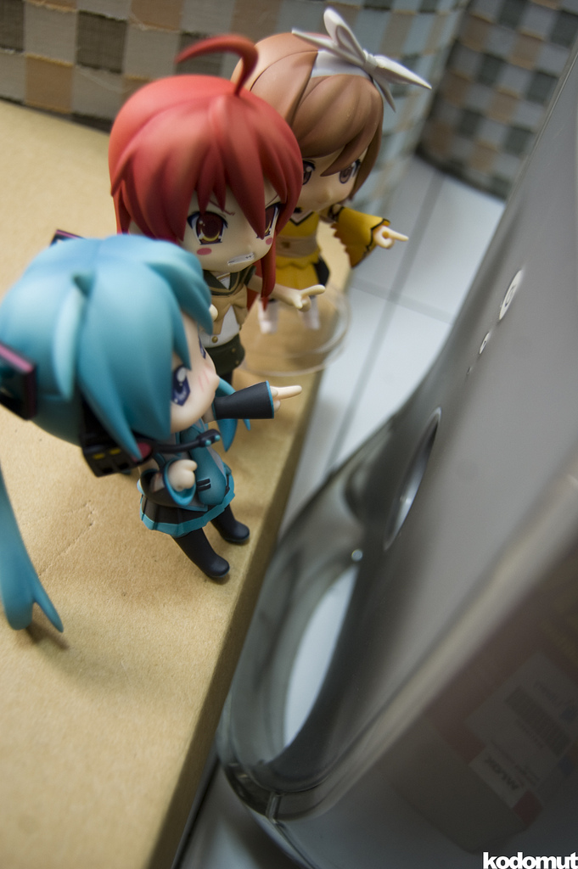
What is Next?
Take the short quiz (podium to your left if you are reading this). This short quiz is to provide you an idea of “how much” you know about STI’s.
After you complete the exhibit, there will be a board with further instructions. The SL Research Control Group will have to complete the SL survey and after-survey to be eligible for the $300.00 drawing.

