Slide 1
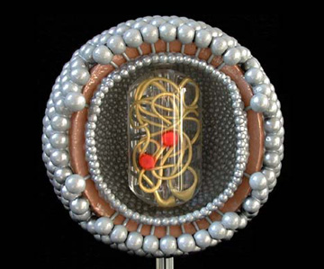
What is Human Immunodeficiency Virus (HIV)?
HIV is is caused by one or two RETROVIRUSES (HIV-1 & HIV-2)
HIV-2 tends to be limited to West Africa
HIV progressively destroys some types of white blood cells called CD4+ lymphocytes. In plain terms, this virus attacks the blood cells that maintain your immune system healthy.
AIDS he most severe form of HIV infection. HIV infection is considered to be AIDS when at least one serious complicating illness develops or the number (count) of CD4⁺ lymphocytes decreases substantially.
HIV has mainly been transmitted through male homosexual contact and the sharing of needles among injecting drug users in the US, Europe, and Australia
In the United States, about 30% of adults who have HIV infection are women

Slide 2
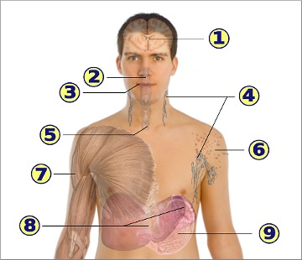
Symptoms and/or manifestations of HIV
Systemic: fever and weight loss
Feeling sick, headache, neuropathy
Sore throat
Swollen glands
Sores and oral yeast infection
Sores
Skin rashes
Muscle pain
Liver and Spleen enlargement
Nausea and vomiting

Slide 3
AIDS is manifested by certain types of Cancer…

