Slide 1
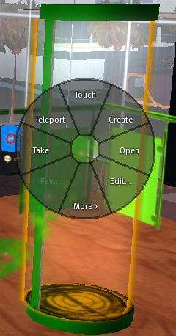
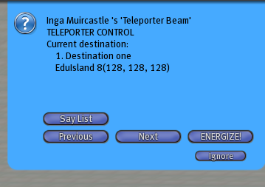
How to use the Teleport Station
In order to get to the exhibit you have to use the “teleport station.” Right-mouse-click on the beam (shiny column of light ) on the wheel choose tele port- see image No. 1.
Once you choose the teleport option your Avatar will sit in the column of light, and a blue “Notecard” will appear on the upper-right corner of your viewer. It has been programmed with just one destination, please proceed to press the ENERGIZE button. See image No. 2.
Image No. 1
Image No. 2

